Slide 1
FUNDAMENTALS OF COMPRESSION

Slide 2
What is Compression?
Reduce the size of data.
Also, Compression is a way to reduce the number of bits in a frame but retaining its meaning.
Advantages:
Reduce storage needed
Reduce transmission cost/latency/bandwidth.
.

Slide 3
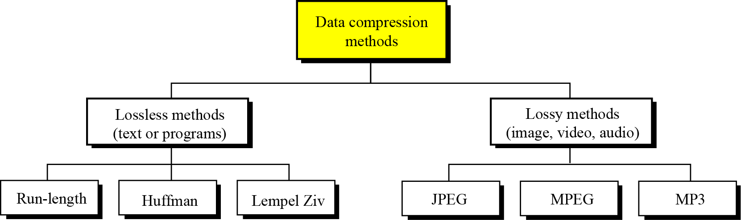
Data Compression Methods

Slide 4
Lossless compression
Lossless compression is a class of data compression that allows the original data to be perfectly reconstructed from the compressed data.
Redundant data is removed in compression and added during decompression.
Most lossless compression programs do two things in sequence: the first step generates a statistical model for the input data, and the second step uses this model to map input data to bit sequences in such a way that "probable" (e.g. frequently encountered) data will produce shorter output than "improbable" data.

Slide 5
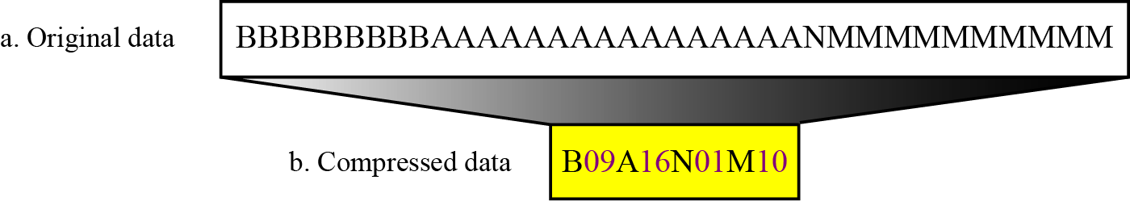
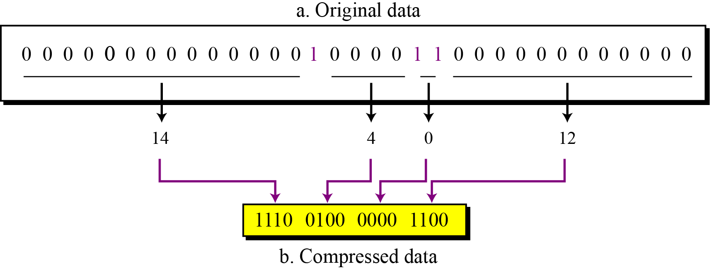
Run-length encoding
Simplest method of compression.
How: replace consecutive repeating occurrences of a symbol by 1 occurrence of the symbol itself, then followed by the number of occurrences.
The method can be more efficient if the data uses only 2 symbols (0s and 1s) in bit patterns and 1 symbol is more frequent than another.

Slide 6
Huffman Coding
Assign fewer bits to symbols that occur more frequently and more bits to symbols appear less often.
There’s no unique Huffman code and every Huffman code has the same average code length.
Algorithm:
Make a leaf node for each code symbol
Add the generation probability of each symbol to the leaf node
Take the two leaf nodes with the smallest probability and connect them into a new node
Add 1 or 0 to each of the two branches
The probability of the new node is the sum of the probabilities of the two connecting nodes
If there is only one node left, the code construction is completed. If not, go back to (2)

Slide 7
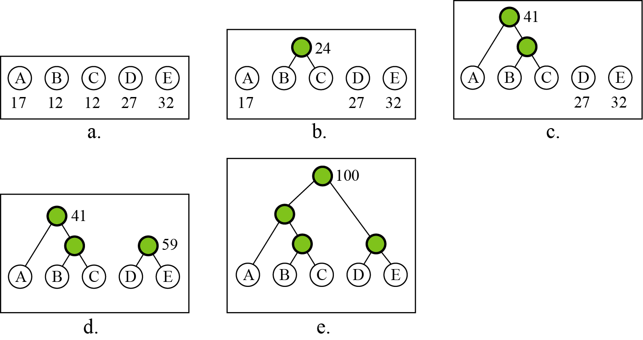
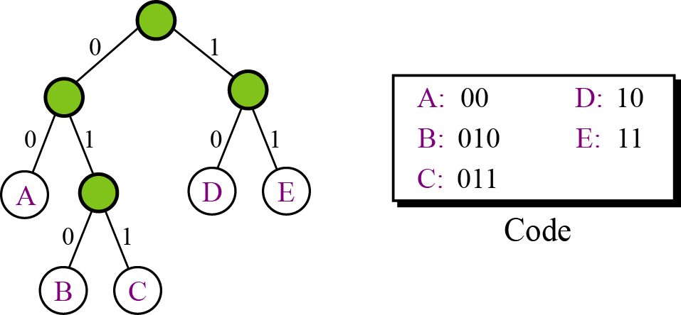
Huffman Algorithm:
For example,

Slide 8
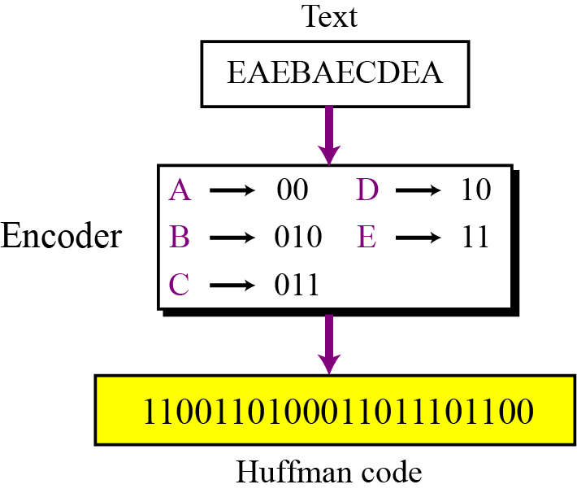
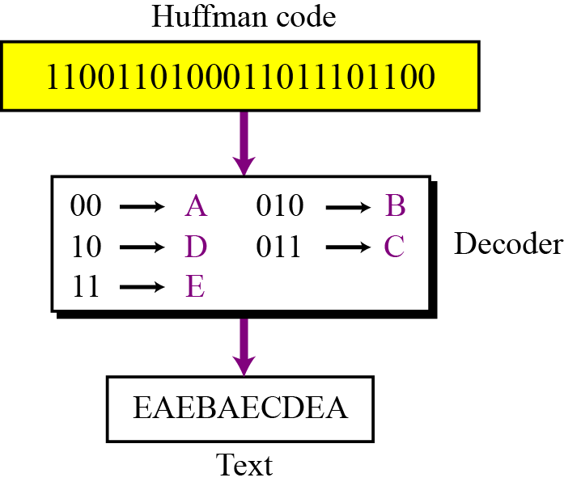
How the encoding and decoding process takes place?
Encoding:
Decoding:

Slide 9
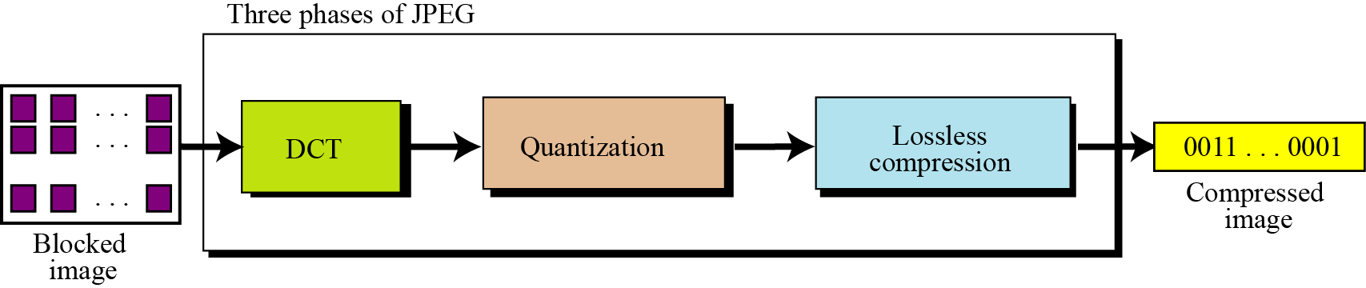
Method 1:JPEG Encoding
Used to compress pictures and graphics.
In JPEG, a grayscale picture is divided into 8x8 pixel blocks to decrease the number of calculations.
Basic idea:
Change the picture into a linear (vector) sets of numbers that reveals the redundancies.
The redundancies is then removed by one of lossless.

Slide 10
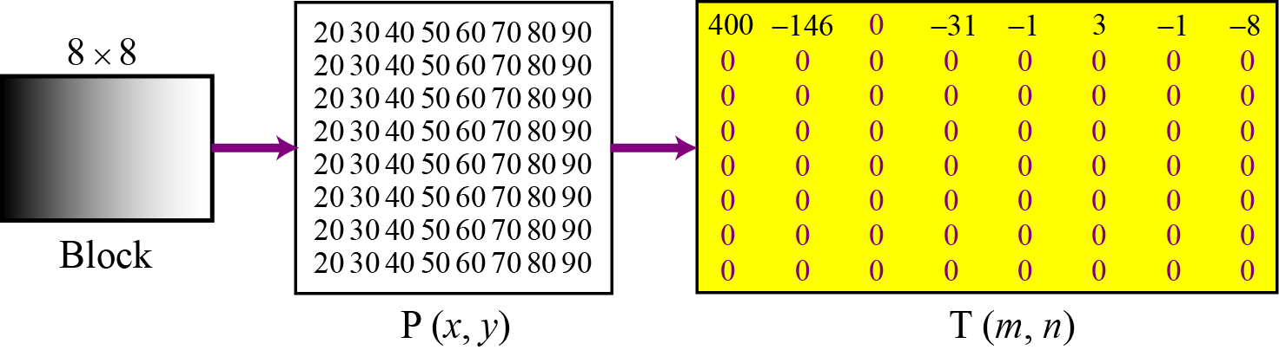
JPEG Encoding- DCT
DCT: Discrete Concise Transform
DCT transforms the 64 values in 8x8 pixel block in a way that the relative relationships between pixels are kept but the redundancies are revealed.
Example:
A gradient grayscale

Slide 11
Quantization & Compression
Quantization:
After T table is created, the values are quantized to reduce the number of bits needed for encoding.
Quantization divides the number of bits by a constant, then drops the fraction. This is done to optimize the number of bits and the number of 0s for each particular application.
Compression:
Quantized values are read from the table and redundant 0s are removed.
To cluster the 0s together, the table is read diagonally in an zigzag fashion. The reason is if the table doesn’t have fine changes, the bottom right corner of the table is all 0s.
JPEG usually uses lossless run-length encoding at the compression phase.

Slide 12
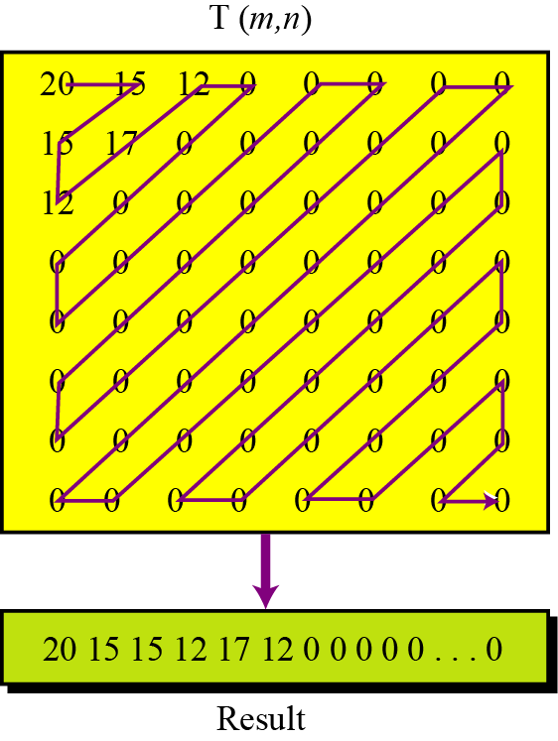
JPEG Encoding

Slide 13
Method 2:MPEG Encoding
Used to compress video.
Basic idea:
Each video is a rapid sequence of a set of frames. Each frame is a spatial combination of pixels, or a picture.
Compressing video =
spatially compressing each frame
+
temporally compressing a set of frames.

Slide 14
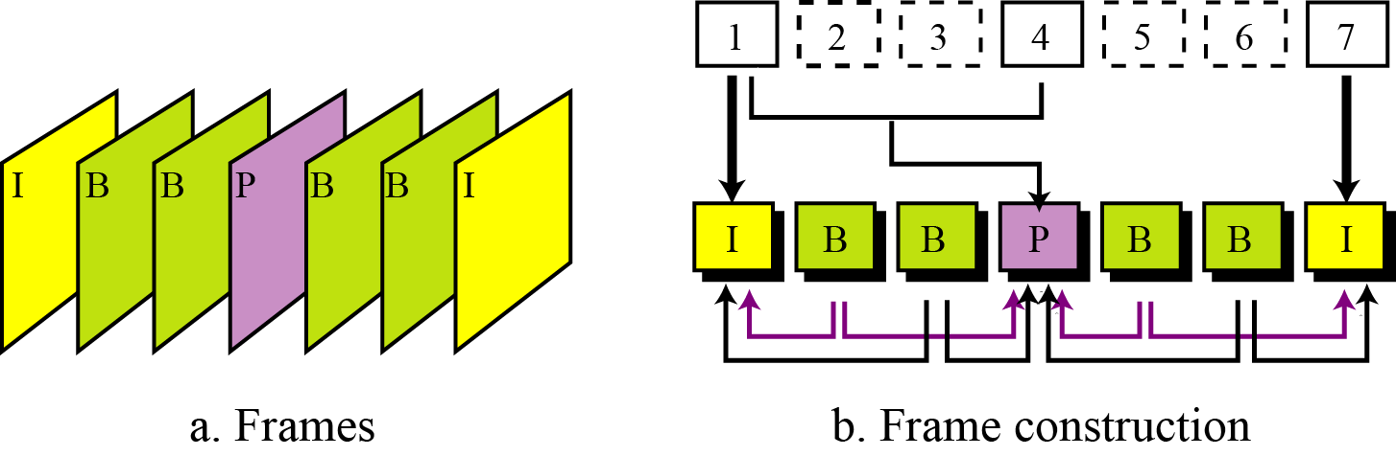
Types of MPEG compression
Spatial Compression
Each frame is spatially compressed by JPEG.
Temporal Compression
Redundant frames are removed.
For example, in a static scene in which someone is talking, most frames are the same except for the segment around the speaker’s lips, which changes from one frame to the next.

Slide 15
Method 3:Audio(or)Mp3 Encoding
Used for speech or music
Speech: compress a 64 kHz digitized signal
Music: compress a 1.411 MHz signal
Two categories of techniques:
Predictive encoding
Perceptual encoding

Slide 16
Categories:
Predictive Encoding
Only the differences between samples are encoded, not the whole sample values.
Several standards: GSM (13 kbps), G.729 (8 kbps), and G.723.3 (6.4 or 5.3 kbps)
Perceptual Encoding: MP3
CD-quality audio needs at least 1.411 Mbps and cannot be sent over the Internet without compression.
MP3 (MPEG audio layer 3) uses perceptual encoding technique to compress audio.

Slide 17


